Slide 1

Assessing Software Vulnerabilities on the Black Market Kaleb Alstott Northern Kentucky University
Fall of 2022

Slide 2
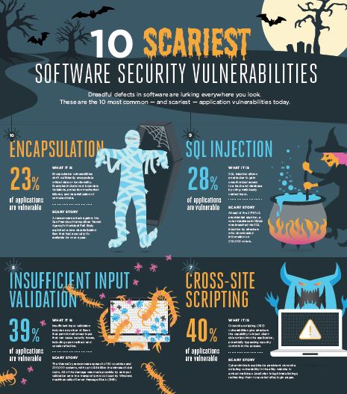
Background
Software Vulnerabilities:
A software vulnerability is a “security flaw, glitch, or weakness found in software code that could be exploited by an attacker (threat source)”
This weakness in the software can be used to exploit privilege access controls, download malicious content, encrypt data, and much worse.
Software vulnerabilities are at an all-time high, “66,000 valid vulnerabilities this year - over 20% more than 2020 - with hacker-powered pen tests seeing a 264% increase in reported vulnerabilities.” (HackerOne)

Slide 3

Background
Black Market:
A market that is usually illegal transactions of goods and services in which take place at prices higher than a legal maximum.
In every market there is always going to be your buyers and sellers.
In our case of software vulnerabilities on the black market we have (typically) black hat hackers who work in the underground and are anonymous.

Slide 4
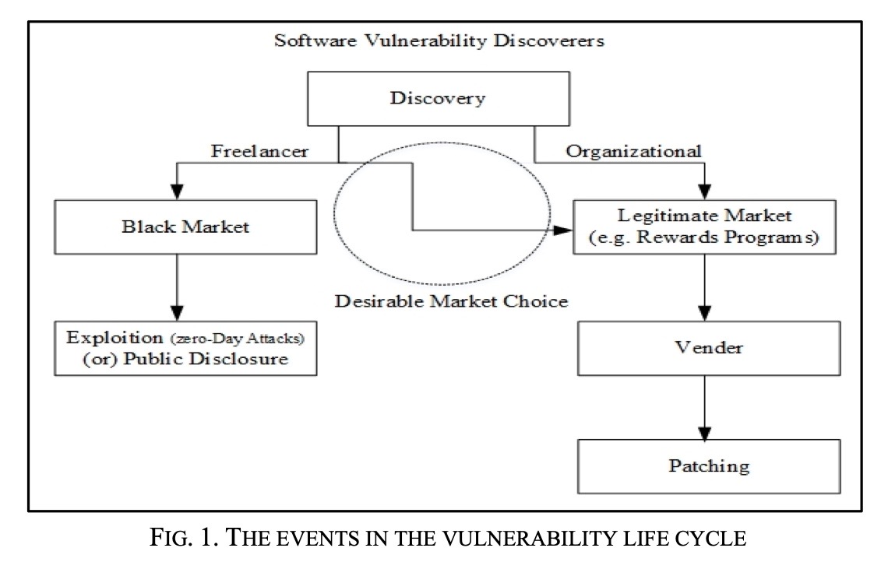
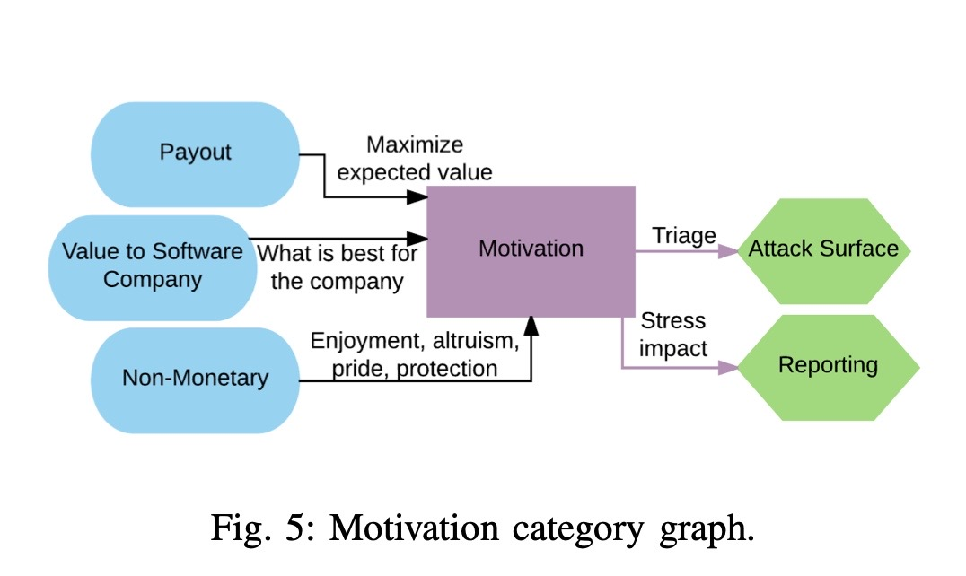
Motivation
Overall - Financial Reward
Why are software vulnerabilities being sold on the black market ?
Main reason for hackers to search for these software vulnerabilities is to obtain higher opportunity for financial achievement through successful exploitation.
Software vulnerability transactions are attractive to black hat hackers and others due to the increase in prices in the evolving black market
Black Market pricing is typically higher than what companies would pay
Recently however these vulnerabilities are now being sold to whoever the highest bidder might be

Slide 5
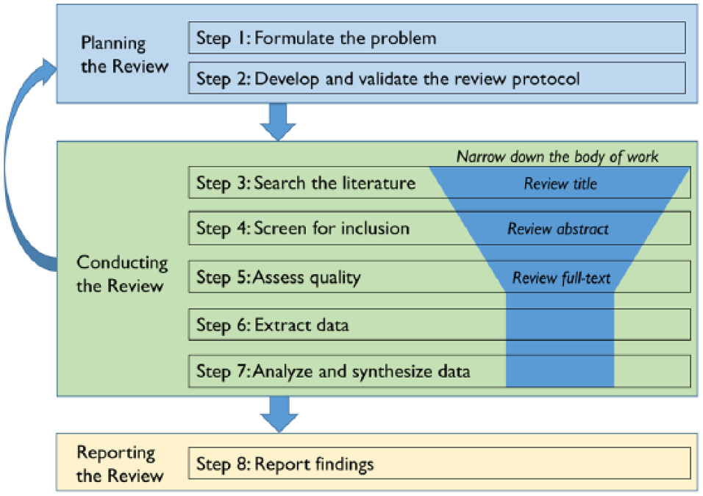
Method
A systematic literature review (SLR)
By following these steps
Starting with a problem
software vulnerabilities on the black market
Research of scholar articles
Found 8 scholar research articles sources
Review articles
Title
Abstract
Full read
Analyze and synthesize the data and findings
Report of the research gap

Slide 6
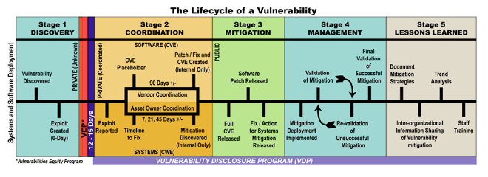
Results
Black market is active due to the findings of, a large fraction of the discoverers are from outside of the software development organizations
Black market emergence and growth has caused an increased number of zero-day exploits
The relationship of the software vulnerability lifecycle is a direct coloration to the vulnerability market
The vulnerability market lifecycle- vulnerability is found and enters the black market where the price can fluctuate depending on the severity, time of discovery, application/software, type of vulnerability found, and if patched.
Both lifecycles depend on each other

Slide 7
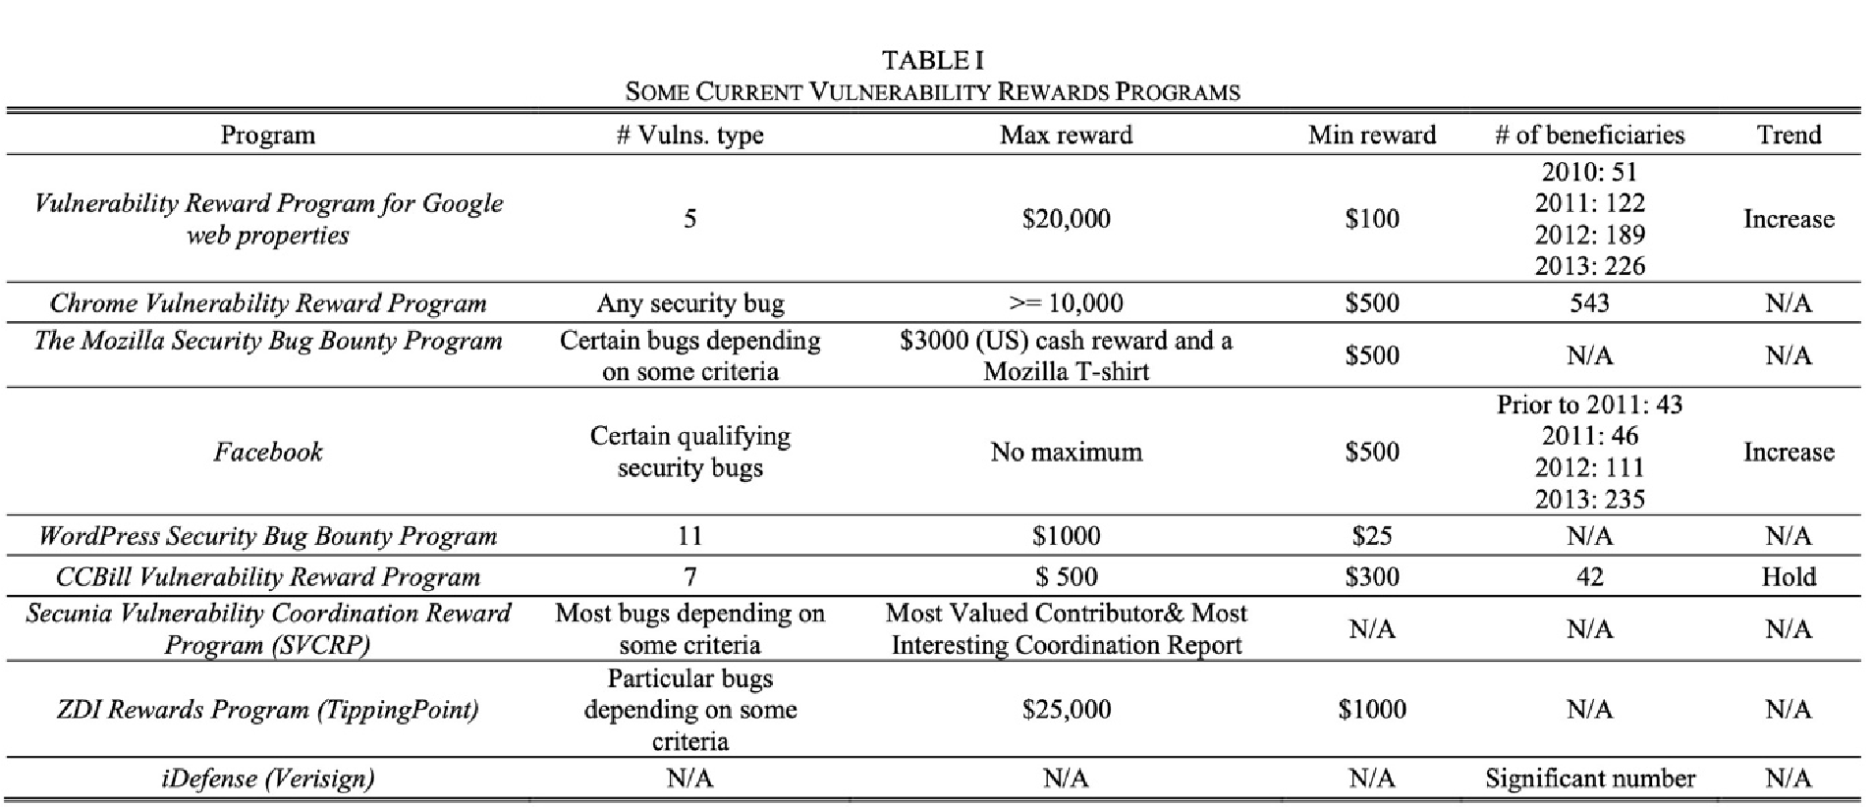
Results of Legal Market
Rewards programs have been introduced to companies in the past decade
Rewards are benefiting both the seller and buyer but also help improve our technology and understanding in a proper disclosed form
Simulation model show that illegal markets end up producing an increase in our software quality, patching speed
If we do switch to a legal market, our overall software quality will be affected due to the transition in the market. (Radianti, Rich and Gonzalez)

Slide 8
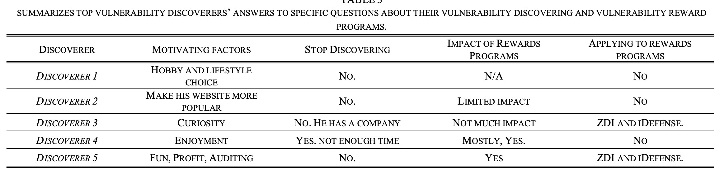
Results of Legal Market
What is stopping us from forming a legal market?
Correct transactions
Wants, needs, supply and demand, and a proper way of disclosing the vulnerability.
Need a firm statistical data of transaction on legal and illegal markets
Properly pricing and creating a sustainable market without knowing trends and cycles in a legal market
Three further steps that we need to take
The need to create new vulnerability markets that is suitable for the different types of vulnerability discoverers
Our markets should be legitimate, attractive, and easy to deal with, so they are a good income source for both sellers and buyers
Studying the rewards buyers give to sellers should be reasonable, depending on supply and demand and other commercial market concepts

Slide 9

Results Machine Learning
Goal: Machine learning technique can predict, indicate, and monitor software vulnerabilities on the illegal market
The idea of a new scoring system for vulnerabilities, vulnerability exploitation based on software structure properties, and the monitoring of the black market, can be properly implemented.
Developed model that uses machine learning to predict rather a vulnerability is likely to be exploited or not (Younis and Malaiya)

Slide 10

Results Machine Learning
A new metric that can be used for earlier detection and as an indicator
Patching strategies based on black market observations can be much more effective than those based on the traditional CVSS score by average of 20%
Still learning and adapting to the ever-changing dynamic field of cyber-attacks and software vulnerabilities

Slide 11

Conclusion
Strong correlation of a dynamically changing field
Strong correlation between the emergence and growth of the black market has caused a rise in the zero-day exploits that companies are suffering from today
Have found a strong correlation between the vulnerability lifecycle and the lifecycle of the illegal market.
A shift towards a legal market already with companies, offering financial rewards for vulnerabilities found in their software considering the still active black market.

Slide 12

Conclusion
Machine learning technique can predict, indicate, and monitor software vulnerabilities on the illegal market
New metric score based off Patching strategies that is 20% more effective than those based on the traditional CVSS score by average of 20%
In this field, our data and content is changing daily and to keep up, we need extensive research with statistical data.
This can be challenging though because it is extremely difficult to find and track this evidence
This is due to the privacy and limited interactions on the black market that take place in private chats, as well as private transactions between the buyer and seller.

Slide 13

Future Work
Further research on both legal and illegal market transactions
The need to collect data about the transactions in the regulated and the unregulated markets so that the processes can be modeled accurately
Studying the rewards buyers give to sellers should be reasonable depending on the supply and demand, as well as other commercial market concepts.

Slide 14

Future Work
Conducting a relevant study on the dynamic changing field to conclude any patterns, attack types, particular users, and most of all an analytic comparison between studies showing similarities between the two markets.
Studies such as this need to be repeated in order to see if there are any observable trends in terms of the vulnerabilities that end up in the legitimate and black market
Bring attention to is the idea of having both the legal and illegal markets running.

Slide 15

Thank you for listening!
Questions?
Comments?
Suggestions?

